Slide 1
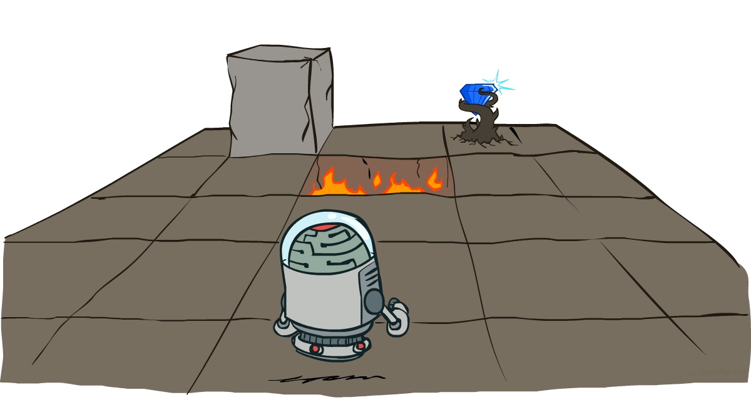
Markov Decision Processes
[These slides were created by Dan Klein and Pieter Abbeel for CS188 Intro to AI at UC Berkeley. ]
Notes:
Please retain proper attribution, including the reference to ai.berkeley.edu. Thanks!
‹#›

Slide 2
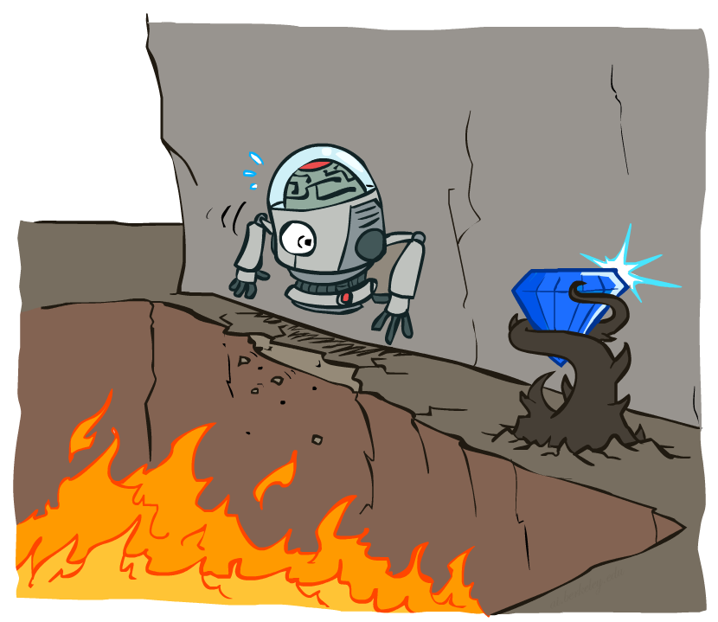
Non-Deterministic Search

Slide 3
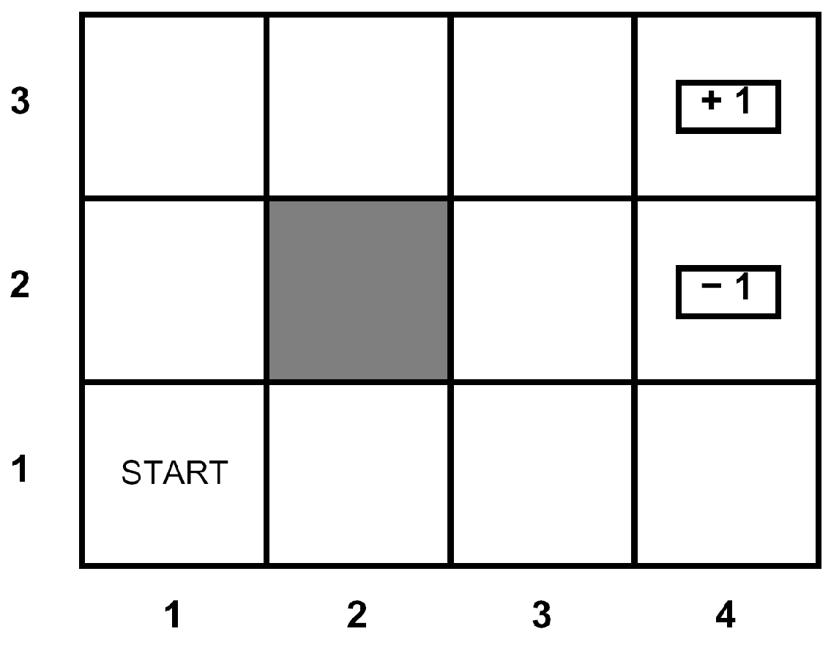





Example: Grid World
A maze-like problem
The agent lives in a grid
Walls block the agent’s path
Noisy movement: actions do not always go as planned
80% of the time, the action North takes the agent North (if there is no wall there)
10% of the time, North takes the agent West; 10% East
If there is a wall in the direction the agent would have been taken, the agent stays put
The agent receives rewards each time step
Small “living” reward each step (can be negative)
Big rewards come at the end (good or bad)
Goal: maximize sum of rewards
Notes:
‹#›

Slide 4
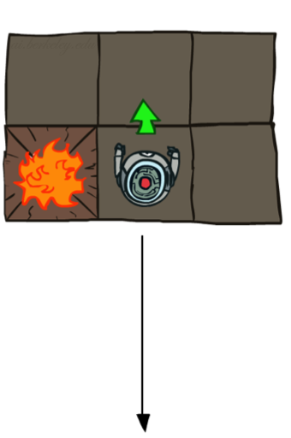
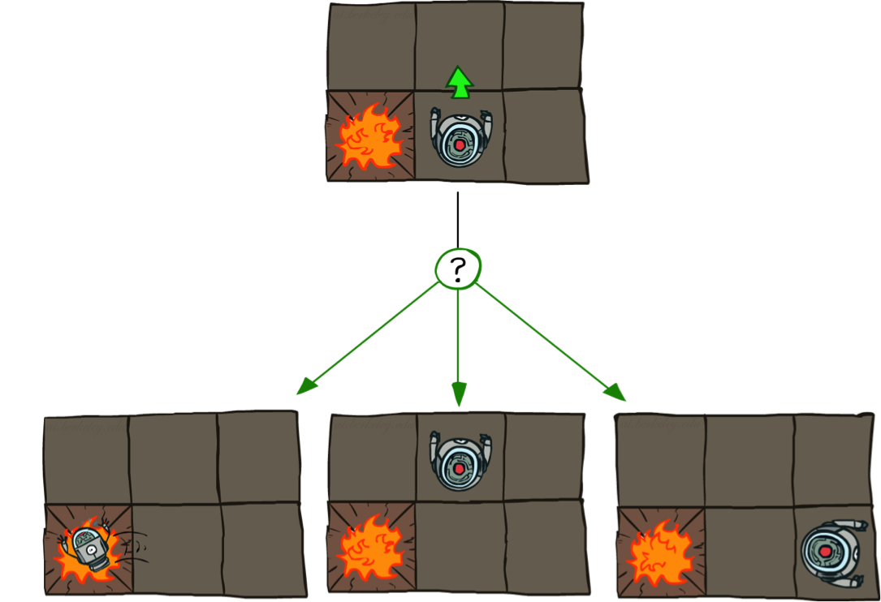

Grid World Actions
Deterministic Grid World
Stochastic Grid World

Slide 5
Markov Decision Processes
An MDP is defined by:
A set of states s ∈ S
A set of actions a ∈ A
A transition function T(s, a, s’)
Probability that a from s leads to s’, i.e., P(s’| s, a)
Also called the model or the dynamics
A reward function R(s, a, s’)
Sometimes just R(s) or R(s’)
A start state
Maybe a terminal state
MDPs are non-deterministic search problems
[Demo – gridworld manual intro (L8D1)]
Notes:
In search problems: did not talk about actions, but about successor functions --- now the information inside the successor function is unpacked into actions, transitions and reward
Write out S, A, example entry in T, entry in R
Reward function different from the book : R(s,a,s’)
In book simpler for equations, but not useful for the projects.
Need to modify expectimax a tiny little bit to account for rewards along the way, but that’s something you should be able to do, and so you can already solve MDP’s (not in most efficient way)
‹#›

Slide 6
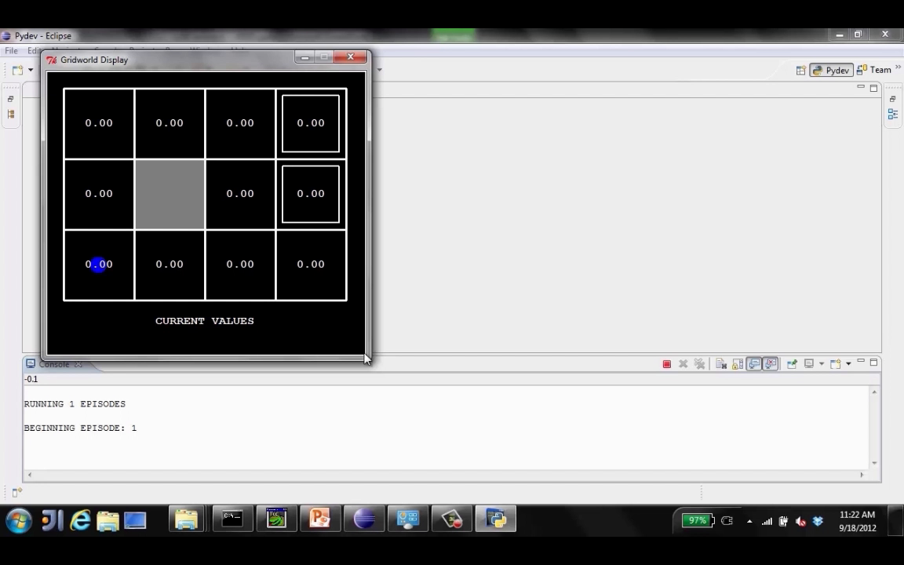
Video of Demo Gridworld Manual Intro

Slide 7

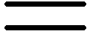
What is Markov about MDPs?
“Markov” generally means that given the present state, the future and the past are independent
For Markov decision processes, “Markov” means action outcomes depend only on the current state
This is just like search, where the successor function could only depend on the current state (not the history)
Andrey Markov (1856-1922)
Notes:
Like search: successor function only depended on current state
Can make this happen by stuffing more into the state;
Very similar to search problems: when solving a maze with food pellets, we stored which food pellets were eaten
‹#›

Slide 8

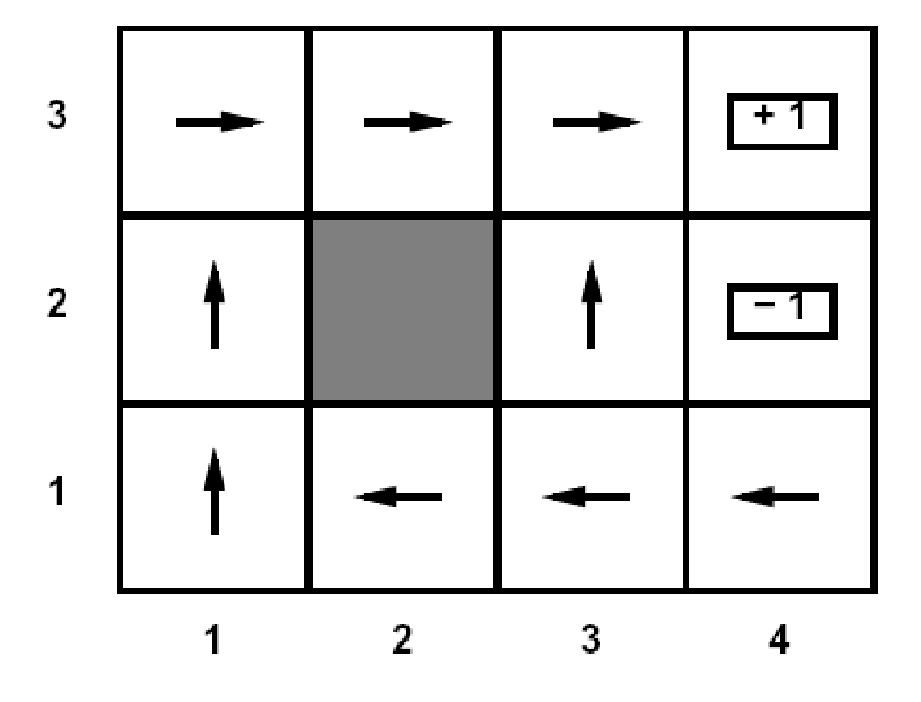
Policies
In deterministic single-agent search problems, we wanted an optimal plan, or sequence of actions, from start to a goal
For MDPs, we want an optimal policy π*: S → A
A policy π gives an action for each state
An optimal policy is one that maximizes expected utility if followed
An explicit policy defines a reflex agent
Optimal policy when R(s, a, s’) = -0.03 for all non-terminals s
Notes:
Dan has a DEMO for this.
‹#›

Slide 9
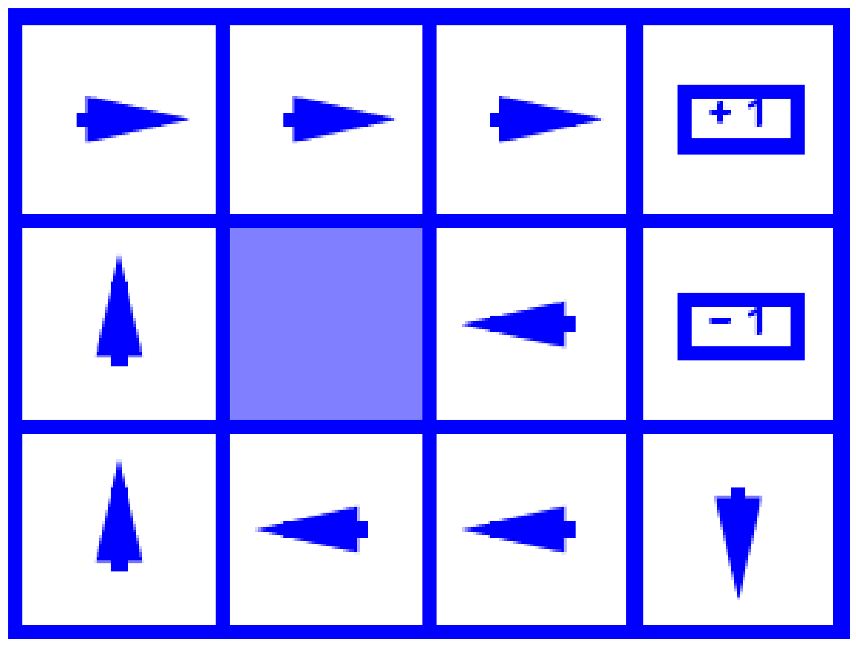
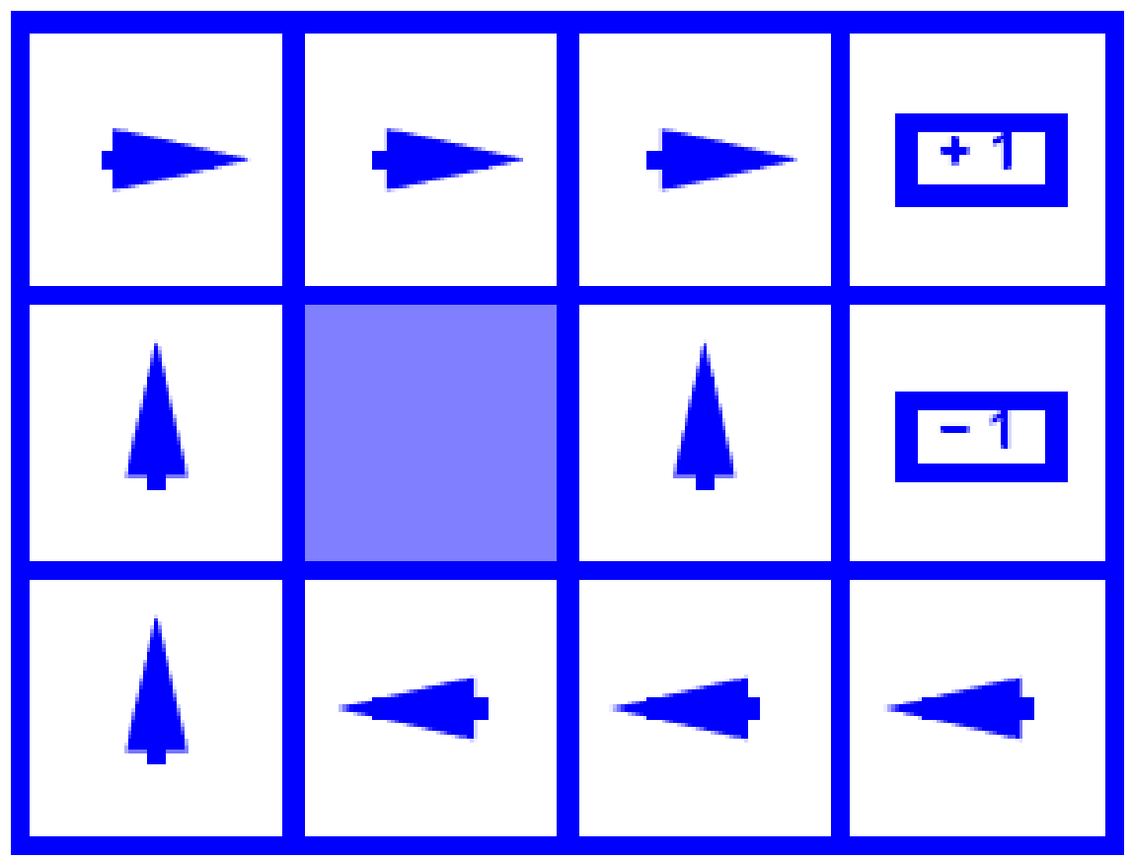
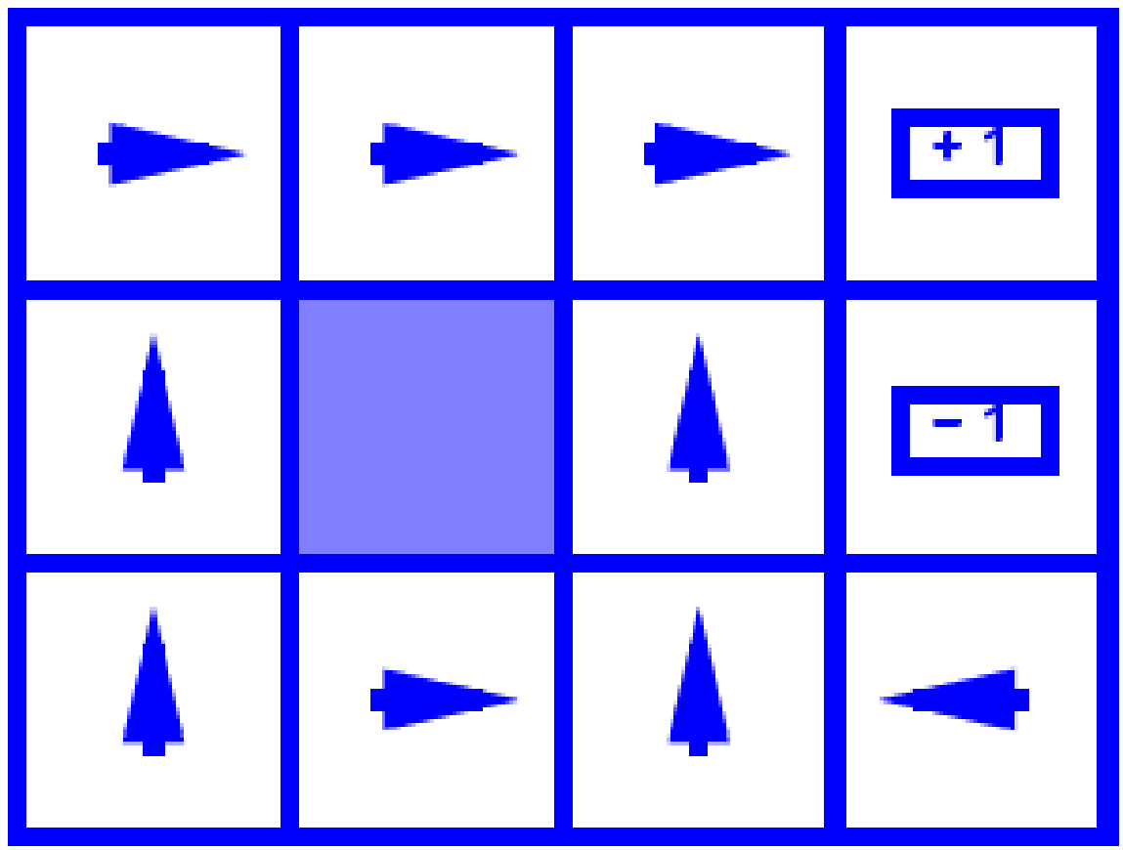
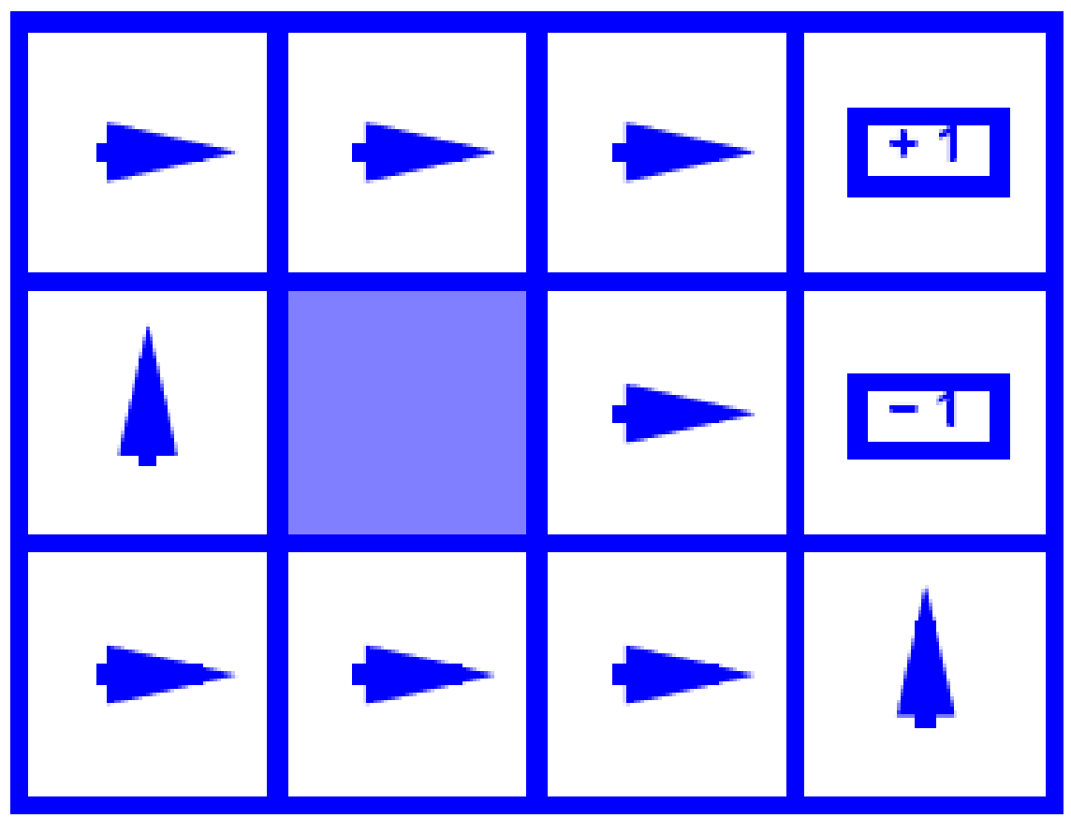
Optimal Policies
R(s) = -0.01
R(s) = -0.03
R(s) = -0.4
R(s) = -2.0
Notes:
R(s) = the “living reward”
‹#›

Slide 10
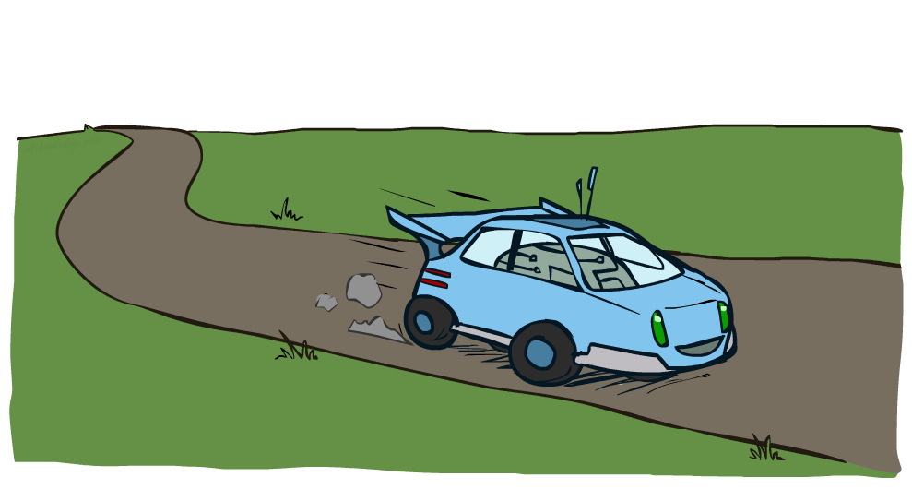
Example: Racing

Slide 11
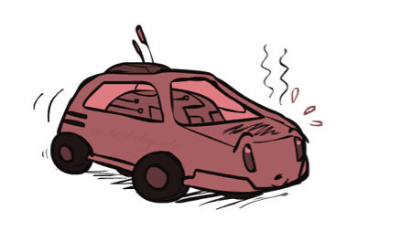
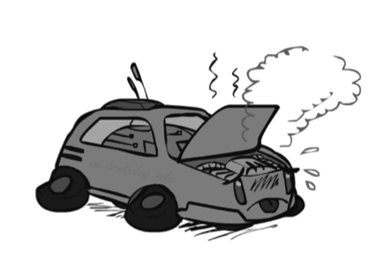

Example: Racing
A robot car wants to travel far, quickly
Three states: Cool, Warm, Overheated
Two actions: Slow, Fast
Going faster gets double reward
0.5
+1
1.0
Fast
Slow
-10
+1
0.5
Warm
Slow
Fast
0.5
+2
Cool
0.5
Overheated
+1
1.0
+2

Slide 12


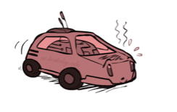
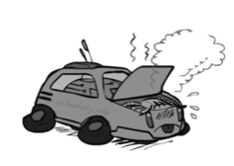
Racing Search Tree

Slide 13
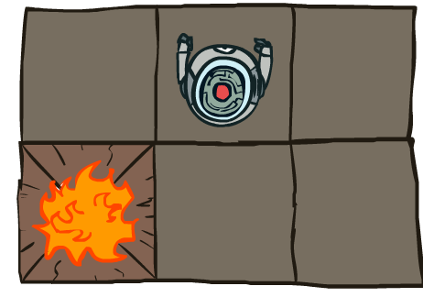


MDP Search Trees
s
s is a state
a
(s, a) is a q-state
s, a
(s,a,s’) called a transition
T(s,a,s’) = P(s’|s,a)
R(s,a,s’)
s,a,s’
s’
Notes:
In MDP chance node represents uncertainty about what might happen based on (s,a) [as opposed to being a random adversary]
Q-state (s,a) is when you were in a state and took an action
‹#›

Slide 14
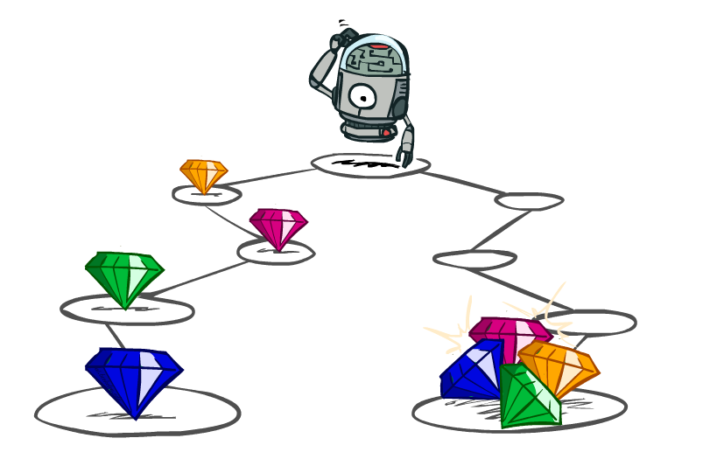
Utilities of Sequences

Slide 15
Utilities of Sequences
What preferences should an agent have over reward sequences?
More or less?
Now or later?
[1, 2, 2]
or
[2, 3, 4]
[0, 0, 1]
or
[1, 0, 0]

Slide 16




Discounting
It’s reasonable to maximize the sum of rewards
It’s also reasonable to prefer rewards now to rewards later
One solution: values of rewards decay exponentially
Worth Now
Worth Next Step
Worth In Two Steps

Slide 17

Discounting
How to discount?
Each time we descend a level, we multiply in the discount once
Why discount?
Sooner rewards probably do have higher utility than later rewards
Also helps our algorithms converge
Example: discount of 0.5
U([1,2,3]) = 1*1 + 0.5*2 + 0.25*3
U([1,2,3]) < U([3,2,1])
Notes:
Rewards in the future (deeper in the tree) matter less
Interesting: running expectimax, if having to truncate the search, then not losing much; e.g., less then \gamma^d / (1-\gamma)
‹#›

Slide 18

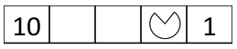
Quiz: Discounting
Given:
Actions: East, West, and Exit (only available in exit states a, e)
Transitions: deterministic
Quiz 1: For Ɣ = 1, what is the optimal policy?
Quiz 2: For Ɣ = 0.1, what is the optimal policy?
Quiz 3: For which Ɣ are West and East equally good when in state d?

Slide 19

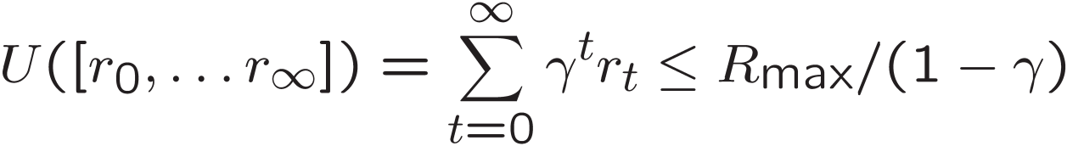
Infinite Utilities?!
Problem: What if the game lasts forever? Do we get infinite rewards?
Solutions:
Finite horizon: (similar to depth-limited search)
Terminate episodes after a fixed T steps (e.g. life)
Gives nonstationary policies (π depends on time left)
Discounting: use 0 < Ɣ< 1
Smaller Ɣ means smaller “horizon” – shorter term focus

Slide 20
Recap: Defining MDPs
Markov decision processes:
Set of states S
Start state s₀
Set of actions A
Transitions P(s’|s,a) (or T(s,a,s’))
Rewards R(s,a,s’) (and discount γ)
MDP quantities so far:
Policy = Choice of action for each state
Utility = sum of (discounted) rewards
s
a
s, a
s,a,s’
s’

Slide 21
Solving MDPs

Slide 22


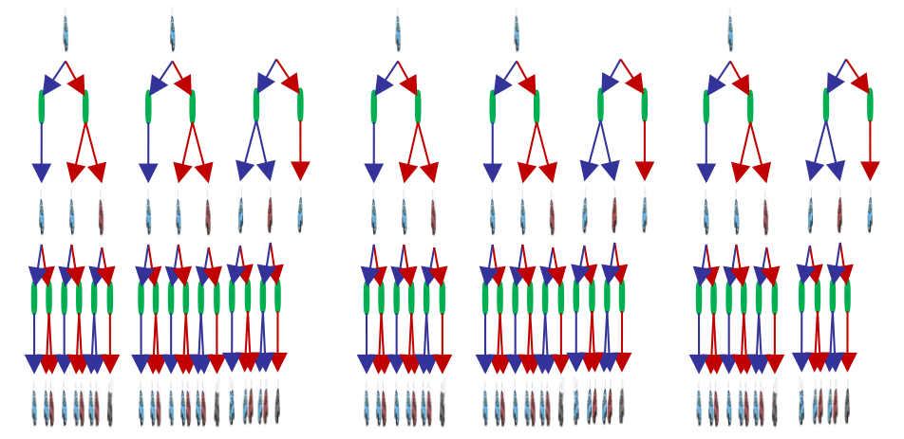

Racing Search Tree

Slide 23
Racing Search Tree
Problem: States are repeated
Idea: Only compute needed quantities once
Problem: Tree goes on forever
Idea: Do a depth-limited computation, but with increasing depths until change is small
Note: deep parts of the tree eventually don’t matter if γ < 1

Slide 24
Optimal Quantities
The value (utility) of a state s:
V*(s) = expected utility starting in s and acting optimally
The value (utility) of a q-state (s,a):
Q*(s,a) = expected utility starting out having taken action a from state s and (thereafter) acting optimally
The optimal policy:
π*(s) = optimal action from state s
s
s is a state
a
(s, a) is a q-state
s, a
s,a,s’
(s,a,s’) is a transition
‘s
[Demo – gridworld values (L8D4)]
Notes:
[Note: this demo doesn’t show anything in action, just pops up V and Q values.]
‹#›

Slide 25
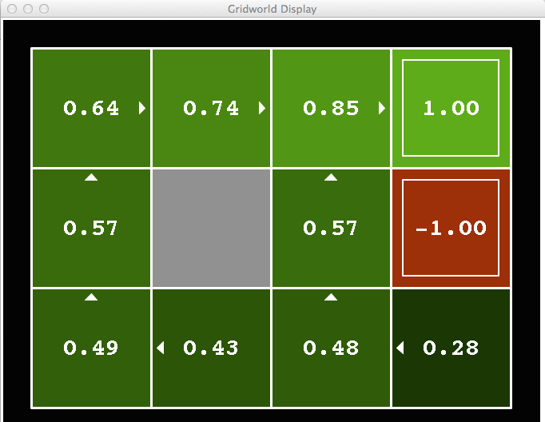
Gridworld V* Values
Noise = 0.2
Discount = 0.9
Living reward = 0
Notes:
This demo doesn’t show anything in action, it just shows the V and Q values.
‹#›

Slide 26
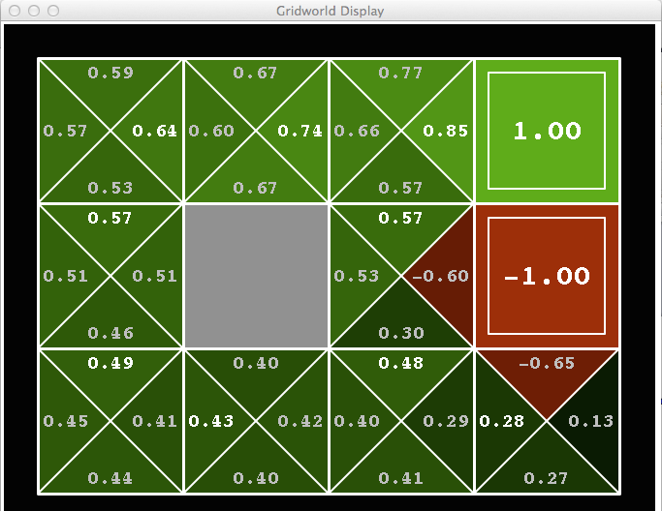
Gridworld Q* Values
Noise = 0.2
Discount = 0.9
Living reward = 0
Notes:
This demo doesn’t show anything in action, it just shows the V and Q values.
‹#›

Slide 27


Values of States
Recursive definition of value:
But how do we solve these equations?
s
a
s, a
s,a,s’
s’

Slide 28


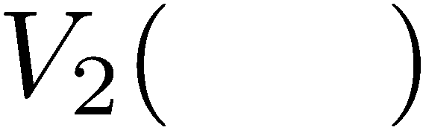


Time-Limited Values
Key idea: time-limited values
Define V_{k}(s) to be the optimal value of s if the game ends in k more time steps
[Demo – time-limited values (L8D6)]
Notes:
This demo generates the time-limited values for gridworld as snapshotted onto the next slides.
‹#›

Slide 29
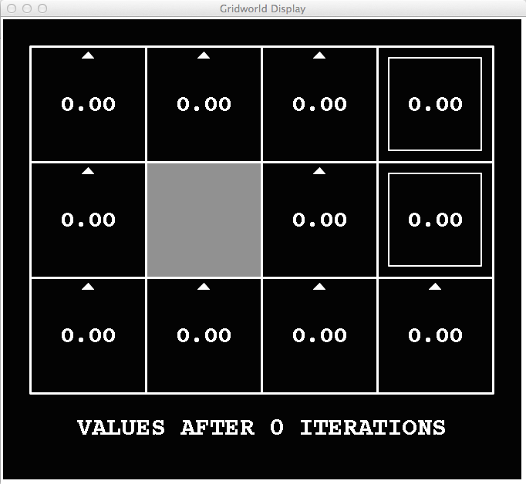
k=0
Noise = 0.2
Discount = 0.9
Living reward = 0
Notes:
Assuming zero living reward
‹#›

Slide 30
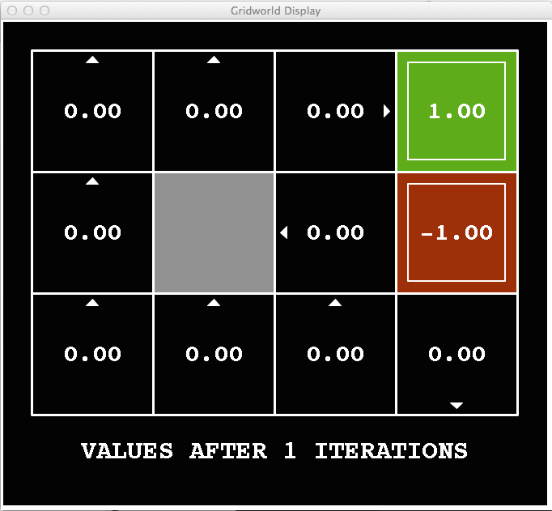
k=1
Noise = 0.2
Discount = 0.9
Living reward = 0
Notes:
Assuming zero living reward
‹#›

Slide 31
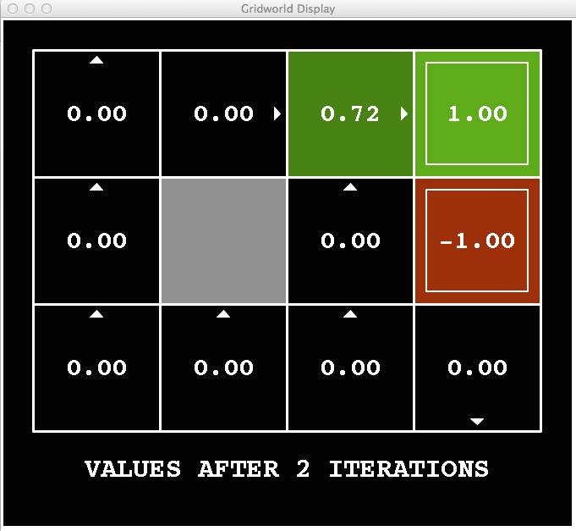
k=2
Noise = 0.2
Discount = 0.9
Living reward = 0
Notes:
Assuming zero living reward
‹#›

Slide 32
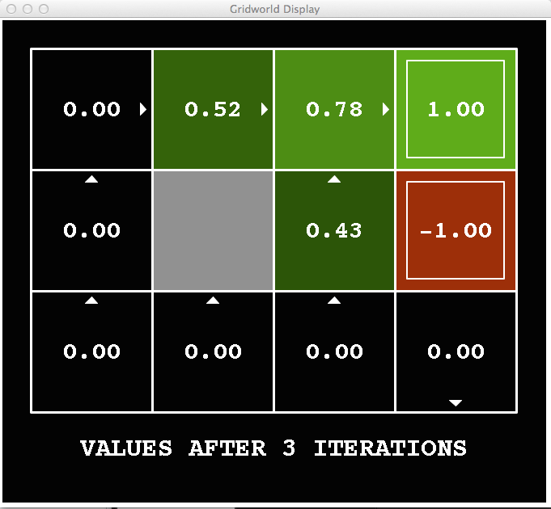
k=3
Noise = 0.2
Discount = 0.9
Living reward = 0
Notes:
Assuming zero living reward
‹#›

Slide 33
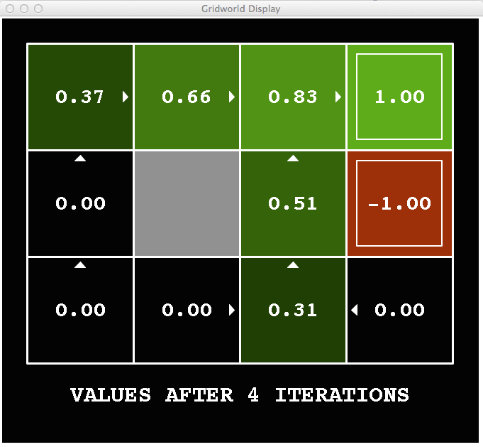
k=4
Noise = 0.2
Discount = 0.9
Living reward = 0
Notes:
Assuming zero living reward
‹#›

Slide 34
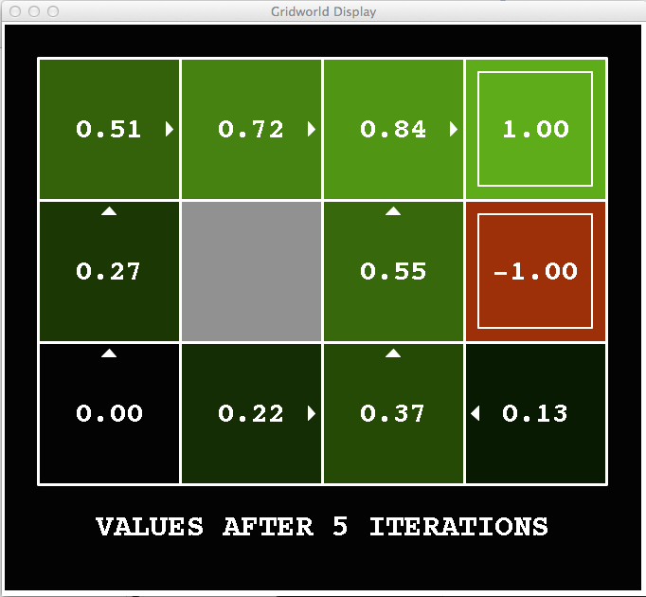
k=5
Noise = 0.2
Discount = 0.9
Living reward = 0
Notes:
Assuming zero living reward
‹#›

Slide 35
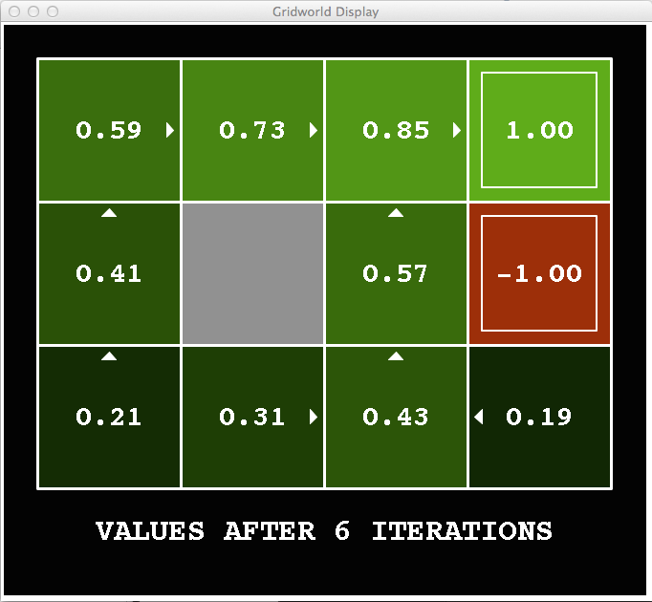
k=6
Noise = 0.2
Discount = 0.9
Living reward = 0
Notes:
Assuming zero living reward
‹#›

Slide 36
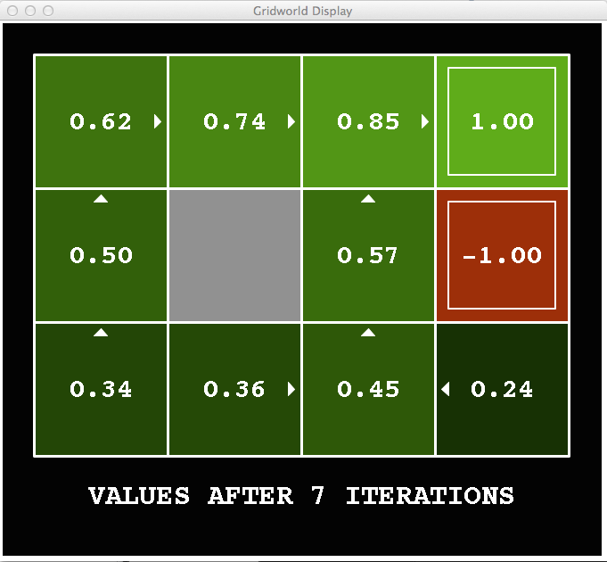
k=7
Noise = 0.2
Discount = 0.9
Living reward = 0
Notes:
Assuming zero living reward
‹#›

Slide 37
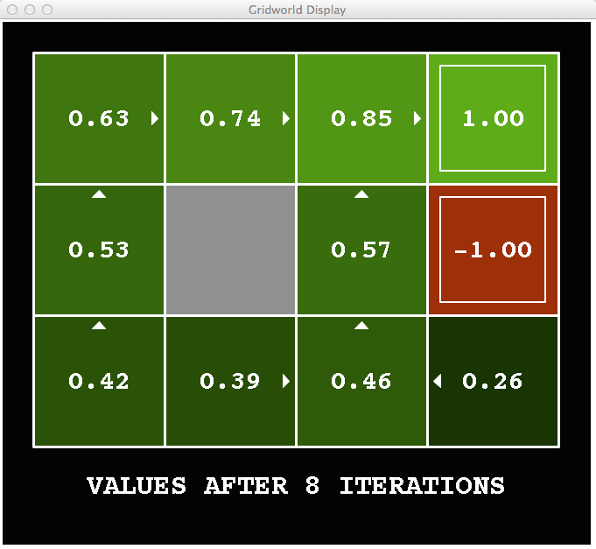
k=8
Noise = 0.2
Discount = 0.9
Living reward = 0
Notes:
Assuming zero living reward
‹#›

Slide 38
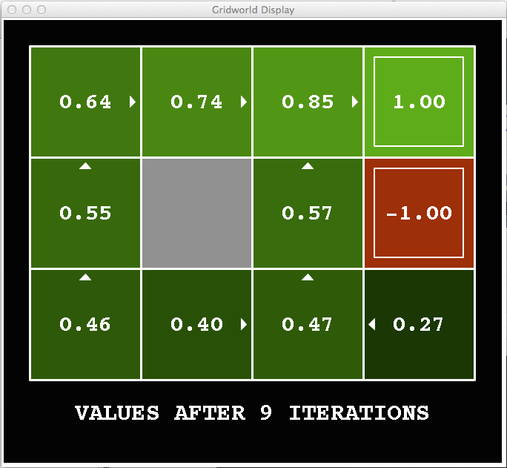
k=9
Noise = 0.2
Discount = 0.9
Living reward = 0
Notes:
Assuming zero living reward
‹#›

Slide 39

k=10
Noise = 0.2
Discount = 0.9
Living reward = 0
Notes:
Assuming zero living reward
‹#›

Slide 40

k=11
Noise = 0.2
Discount = 0.9
Living reward = 0
Notes:
Assuming zero living reward
‹#›

Slide 41
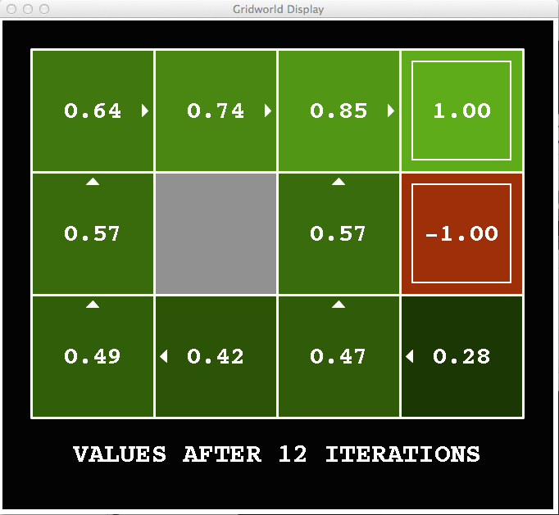
k=12
Noise = 0.2
Discount = 0.9
Living reward = 0
Notes:
Assuming zero living reward
‹#›

Slide 42

k=100
Noise = 0.2
Discount = 0.9
Living reward = 0
Notes:
Assuming zero living reward
‹#›

Slide 43
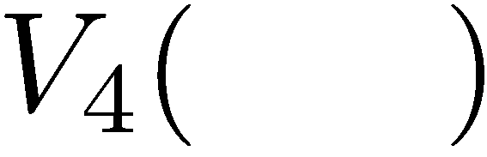

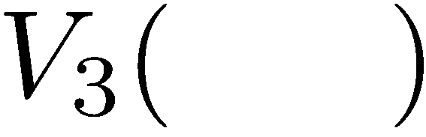
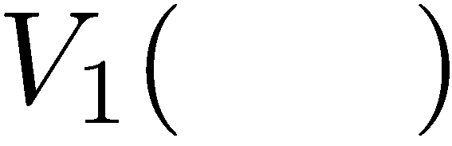
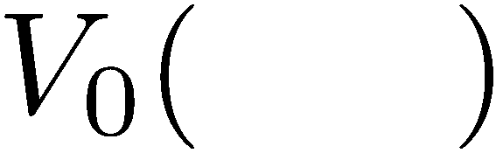
Computing Time-Limited Values

Slide 44
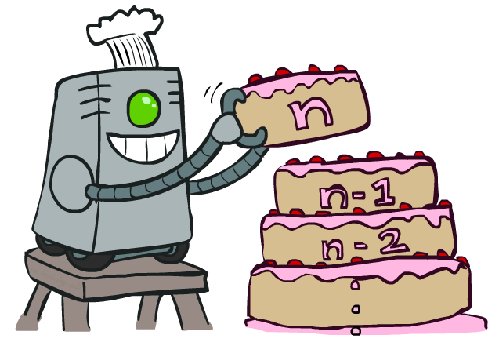
Value Iteration

Slide 45
Optimal Quantities
The value (utility) of a state s:
V*(s) = expected utility starting in s and acting optimally
The value (utility) of a q-state (s,a):
Q*(s,a) = expected utility starting out having taken action a from state s and (thereafter) acting optimally
The optimal policy:
π*(s) = optimal action from state s
s
s is a state
a
(s, a) is a q-state
s, a
s,a,s’
(s,a,s’) is a transition
s’
Notes:
Demo just shows V and Q values, snapshots on next slides.

Slide 46
Value Iteration
Start with V₀(s) = 0: no time steps left means an expected reward sum of zero
Given vector of V_{k}(s) values, do one ply of expectimax from each state:
Repeat until convergence, which yields V*
Complexity of each iteration: O(S²A)
Theorem: will converge to unique optimal values
Basic idea: approximations get refined towards optimal values
Policy may converge long before values do
V_{k+1}(s)
a
s, a
s,a,s’
V_{k}(s’)
Notes:
Discuss computational complexity: S * A * S times number of iterations
Note: updates not in place [if in place, it means something else and not even clear what it means]

Slide 47
Value Iteration
Bellman equations characterize the optimal values:
Value iteration computes them:
V(s)
a
s, a
s,a,s’
V(s’)
Notes:
Discuss computational complexity: S * A * S times number of iterations
Note: updates not in place [if in place, it means something else and not even clear what it means]

Slide 48

The Bellman Equations
How to be optimal:
Step 1: Take correct first action
Step 2: Keep being optimal

Slide 49


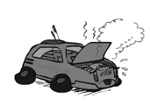
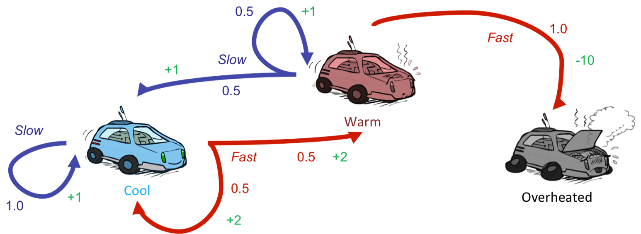
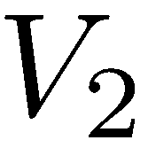
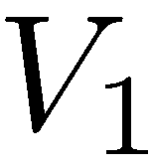
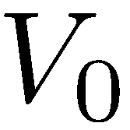
Example: Value Iteration
3.5 2.5 0
2 1 0
Assume no discount!
0 0 0

Slide 50
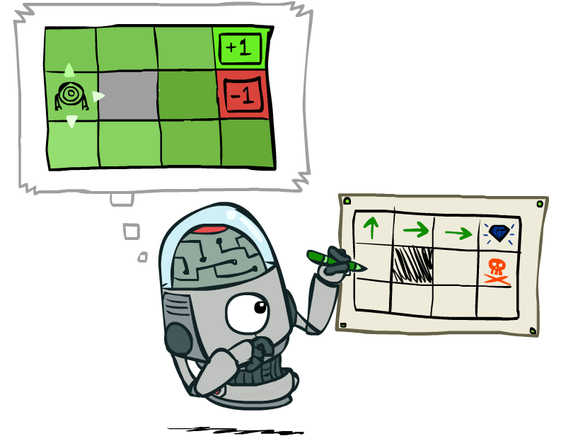
Policy Extraction

Slide 51
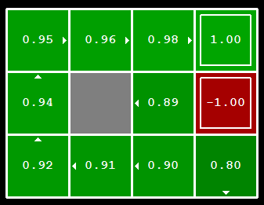
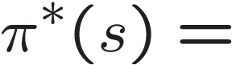
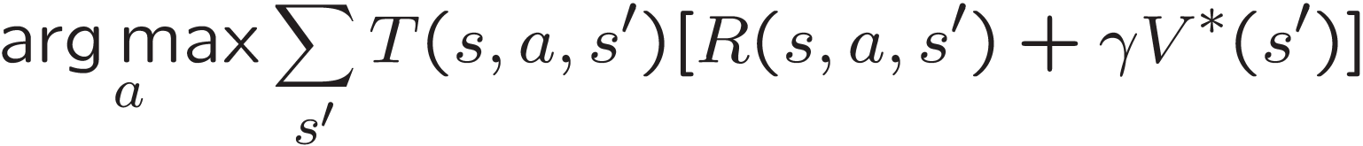
Computing Actions from Values
Let’s imagine we have the optimal values V*(s)
How should we act?
It’s not obvious!
We need to do a mini-expectimax (one step)
This is called policy extraction, since it gets the policy implied by the values

Slide 52


Computing Actions from Q-Values
Let’s imagine we have the optimal q-values:
How should we act?
Completely trivial to decide!
Important lesson: actions are easier to select from q-values than values!

Slide 53

Policy Methods

Slide 54

Problems with Value Iteration
Value iteration repeats the Bellman updates:
Problem 1: It’s slow – O(S²A) per iteration
Problem 2: The “max” at each state rarely changes
Problem 3: The policy often converges long before the values
Notes:
Demo steps through value iteration; snapshots of values shown on next slides.

Slide 55
k=12
Noise = 0.2
Discount = 0.9
Living reward = 0
Notes:
Assuming zero living reward

Slide 56
k=100
Noise = 0.2
Discount = 0.9
Living reward = 0
Notes:
Assuming zero living reward

Slide 57
Policy Iteration
Alternative approach for optimal values:
Step 1: Policy Evaluation: calculate utilities for some fixed policy (not optimal utilities!) until convergence
Step 2: Policy Improvement: update policy using one-step look-ahead with resulting converged (but not optimal!) utilities as future values
Repeat steps until policy converges
This is Policy Iteration
It’s still optimal!
Can converge (much) faster under some conditions

Slide 58

Policy Evaluation

Slide 59


Fixed Policies
Do the optimal action
Do what π says to do
Expectimax trees max over all actions to compute the optimal values
If we fixed some policy π(s), then the tree would be simpler – only one action per state
… though the tree’s value would depend on which policy we fixed

Slide 60

Utilities for a Fixed Policy
Another basic operation: compute the utility of a state s under a fixed (generally non-optimal) policy
Define the utility of a state s, under a fixed policy π:
V^{π}(s) = expected total discounted rewards starting in s and following π
Recursive relation (one-step look-ahead / Bellman equation):

Slide 61


Policy Evaluation
How do we calculate the V’s for a fixed policy π?
Idea 1: Turn recursive Bellman equations into updates
(like value iteration)
Efficiency: O(S²) per iteration
Idea 2: Without the maxes, the Bellman equations are just a linear system
Solve with Matlab (or your favorite linear system solver)

Slide 62


Example: Policy Evaluation
Always Go Right
Always Go Forward

Slide 63


Example: Policy Evaluation
Always Go Right
Always Go Forward

Slide 64

Policy Iteration

Slide 65
Policy Iteration
Evaluation: For fixed current policy π, find values with policy evaluation:
Iterate until values converge:
Improvement: For fixed values, get a better policy using policy extraction
One-step look-ahead:

Slide 66
Comparison
Both value iteration and policy iteration compute the same thing (all optimal values)
In value iteration:
Every iteration updates both the values and (implicitly) the policy
We don’t track the policy, but taking the max over actions implicitly recomputes it
In policy iteration:
We do several passes that update utilities with fixed policy (each pass is fast because we consider only one action, not all of them)
After the policy is evaluated, a new policy is chosen (slow like a value iteration pass)
The new policy will be better (or we’re done)
Both are dynamic programs for solving MDPs

Slide 67
Summary: MDP Algorithms
So you want to….
Compute optimal values: use value iteration or policy iteration
Compute values for a particular policy: use policy evaluation
Turn your values into a policy: use policy extraction (one-step lookahead)
These all look the same!
They basically are – they are all variations of Bellman updates
They all use one-step lookahead expectimax fragments
They differ only in whether we plug in a fixed policy or max over actions

